Slide 1

Quantum Computing
4. Quantum gates
Quantum Computing Insitute
https://qcict.org
Prof. Aleksandar Radovanovic
alex@qcict.org

Slide 2
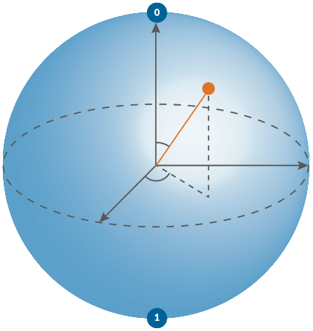

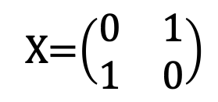
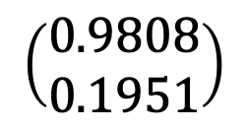
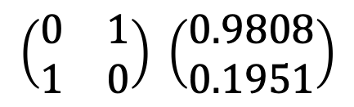
Model of quantum computation
matehematical unit of processing
matrix-vector multiplication
unit of data
qubit/vector
unit of processing
quantum gate/matrix
algorithm
quantum circuit
program
quantum circuit desciption
$$\left(\begin{matrix}0.9808 \\ 0.1951\end{matrix}\right)$$
+
X=$\left(\begin{matrix}0 & 1 \\ 1 & 0\end{matrix}\right)$
$$\left(\begin{matrix}0 & 1 \\ 1 & 0\end{matrix}\right) \left(\begin{matrix}0.9808 \\ 0.1951\end{matrix}\right)$$
+
H
circuit.x (qreg_q[0])
circuit.h (qreg_q[0])
circuit.measure (qreg_q[0], creg_c[0])
Notes:
The basic unit of quantum processing is the quantum gate. Mathematically, a quantum gate is represented by a unitary matrix.
Quantum computation consists of successive transformations of the qubit state. Geometrically, these transformations can be visualized as rotations of the vector. Mathematically, they are represented by multiplying the qubit state vector by the matrix corresponding to a quantum gate, producing a new quantum state.

Slide 3
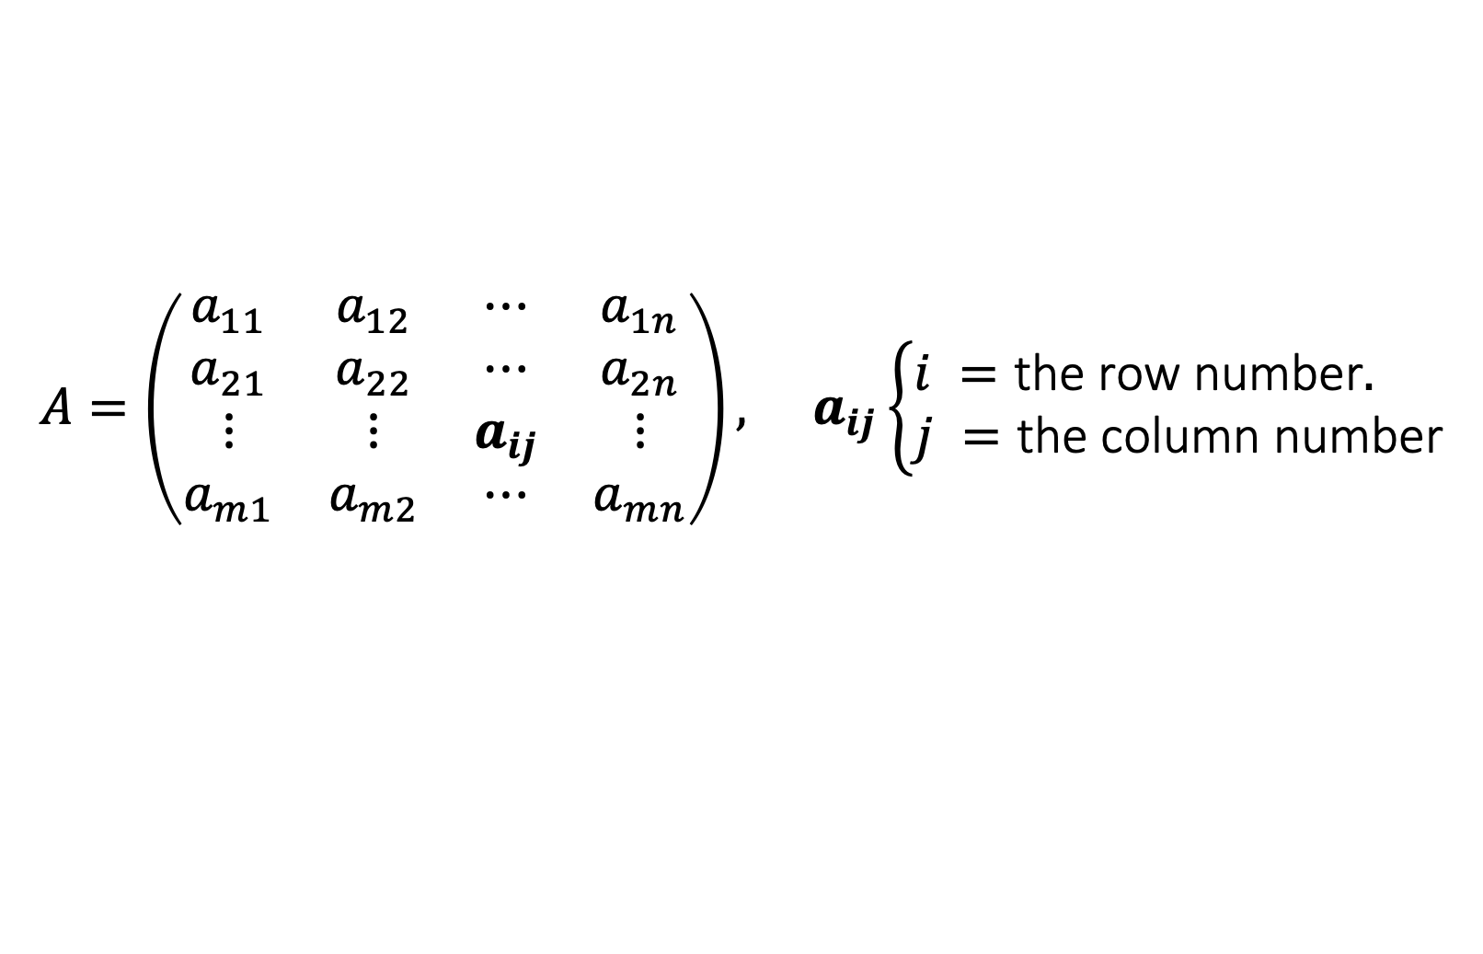
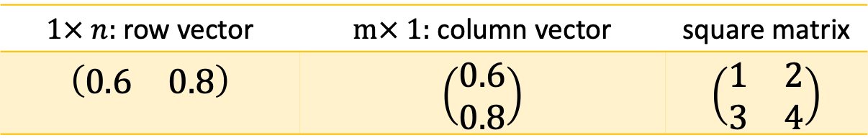
MathBox: Matrix
A matrix is a is a rectangular array or table of numbers, symbols or expressions organized into horizontal rows and vertical columns.
$$\begin{matrix}A=\left(\begin{matrix}a_{11} & a_{12} & ⋯ & a_{1n} \\ a_{21} & a_{22} & ⋯ & a_{2n} \\ ⋮ & ⋮ & a_{ij} & ⋮ \\ a_{m1} & a_{m2} & ⋯ & a_{mn}\end{matrix}\right), & a_{ij}\left\{\begin{matrix}i =\text{the} \text{row} \text{number}. \\ j =\text{the} \text{column} \text{number}\end{matrix}\right.\end{matrix}$$
Matrices used in quantum computing:
$1× n:$ row vector | $m× 1:$ column vector | square matrix
$$\left(\begin{matrix}0.6 & 0.8\end{matrix}\right)$$ | $$\left(\begin{matrix}0.6 \\ 0.8\end{matrix}\right)$$ | $$\left(\begin{matrix}1 & 2 \\ 3 & 4\end{matrix}\right)$$
Notes:
A matrix is a is a rectangular array or table of numbers, symbols or expressions organized into horizontal rows and vertical columns.
Each element of a matrix is denoted as $a_{ij}$​, where:
$i$ represents the row number, and
$j$ represents the column number.
In quantum computing, three matrix shapes are particularly important:
A row vector is a matrix with one row.
A column vector is a matrix with one column.
A square matrix has the same number of rows and columns.

Slide 4
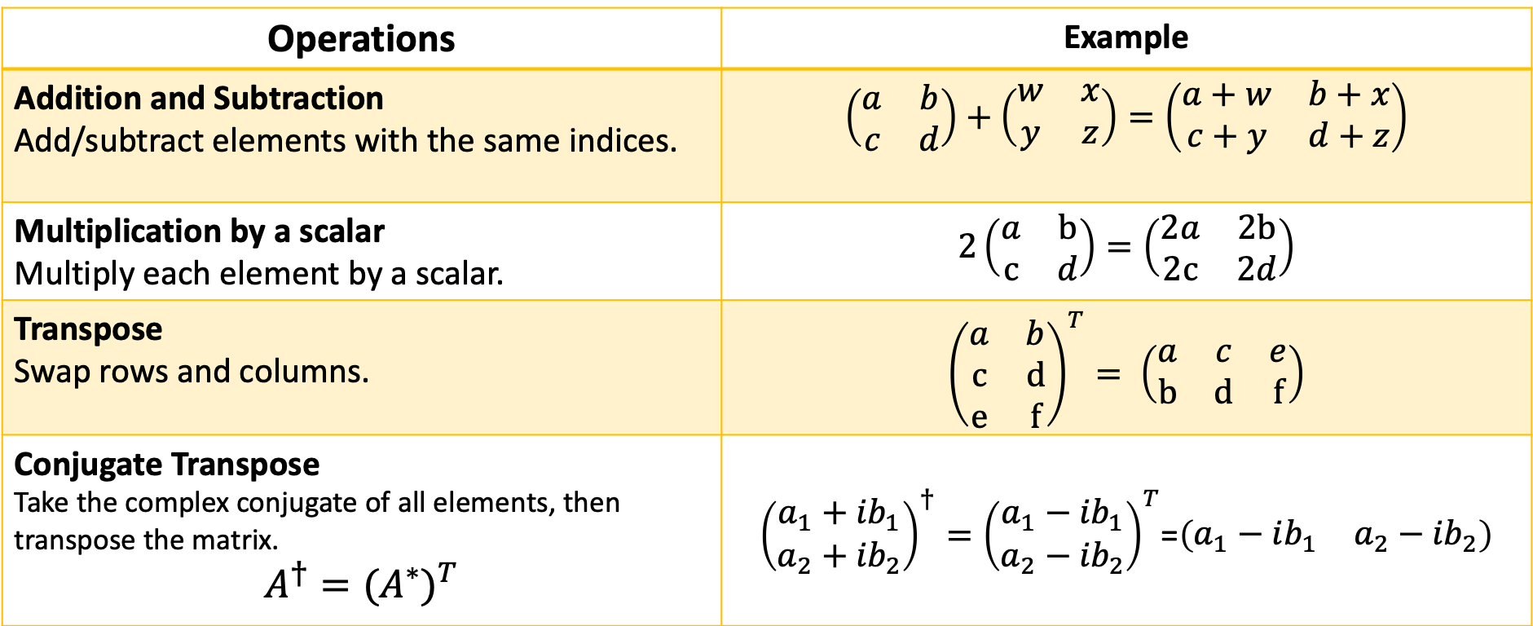
MathBox: Matrix Operations
Operations | Example
Addition and Subtraction Add/subtract elements with the same indices. | $\left(\begin{matrix}a & b \\ c & d\end{matrix}\right)+\left(\begin{matrix}w & x \\ y & z\end{matrix}\right)=\left(\begin{matrix}a+w & b+x \\ c+y & d+z\end{matrix}\right)$
Multiplication by a scalar Multiply each element by a scalar. | $2\left(\begin{matrix}a & b \\ c & d\end{matrix}\right)=\left(\begin{matrix}2a & 2b \\ 2c & 2d\end{matrix}\right)$
Transpose Swap rows and columns. | ${\left(\begin{matrix}a & b \\ c & d \\ e & f\end{matrix}\right)}^{T}= \left(\begin{matrix}a & c & e \\ b & d & f\end{matrix}\right)$
Conjugate Transpose Take the complex conjugate of all elements, then transpose the matrix. $$A^{†}={(A^{∗})}^{T}$$ | ${\left(\begin{matrix}a_{1}+{ib}_{1} \\ a_{2}+{ib}_{2}\end{matrix}\right)}^{†}={\left(\begin{matrix}a_{1}−{ib}_{1} \\ a_{2}−{ib}_{2}\end{matrix}\right)}^{T}$=$\left(\begin{matrix}a_{1}−ib_{1} & a_{2}−{ib}_{2}\end{matrix}\right)$
Notes:
Addition and Subtraction: Two matrices are added or subtracted by performing element-wise operations on corresponding indices.
Scalar Multiplication: A matrix is multiplied by a scalar by multiplying each element by the scalar.
Transpose: The transpose of a matrix is obtained by swapping its rows and columns.
Conjugate Transpose: The conjugate transpose of a matrix is found by taking the complex conjugate of each element and then transposing the matrix. Conjugate Transpose is denoted by a superscript dagger (†).

Slide 5
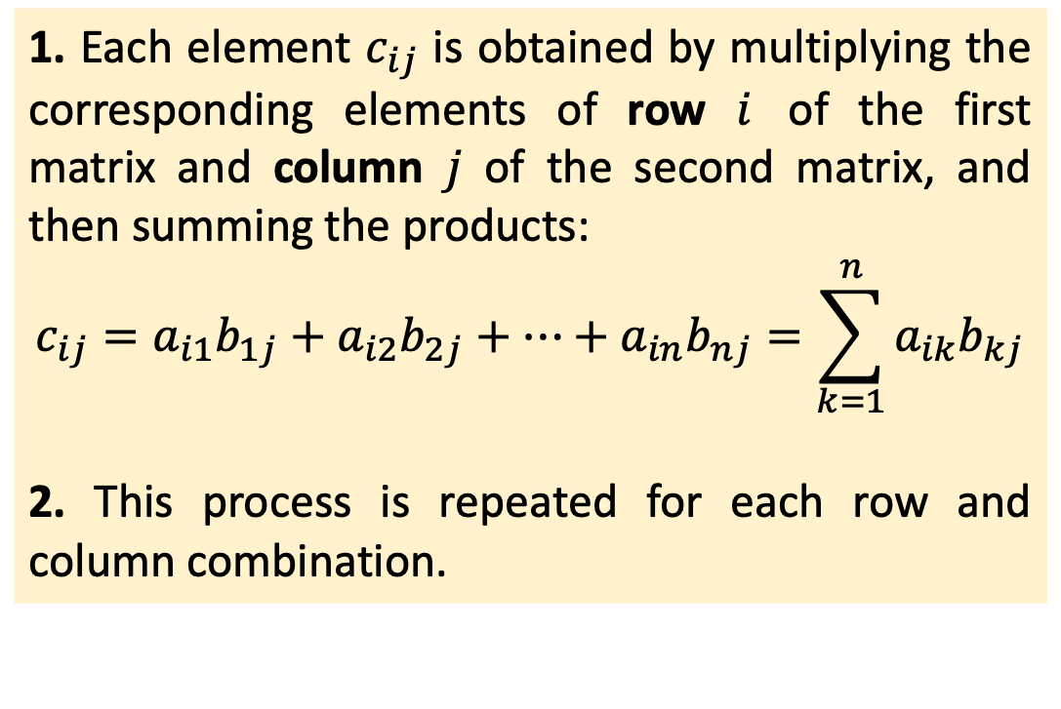
MathBox: Matrix Multiplication
Matrices can be multiplied only if the number of columns in the left matrix equals the number of rows in the right matrix.
1. Each element $c_{ij}$ is obtained by multiplying the corresponding elements of row $i$ of the first matrix and column $j$ of the second matrix, and then summing the products:
$$\begin{matrix}c_{ij}=a_{i1}b_{1j}+a_{i2}b_{2j}+⋯+a_{in}b_{nj}=\sum_{k=1}^{n}{a_{ik}b_{kj}}\end{matrix}$$
2. This process is repeated for each row and column combination.
Notes:
Matrices can be multiplied only if the number of columns in the left matrix equals the number of rows in the right matrix.
Matrix multiplication is performed row by column. Each element $c_{ij}$ is obtained by multiplying the corresponding elements of row $i$ of the first matrix and column $j$ of the second matrix, and then summing the products:
$$\begin{matrix}c_{ij}=a_{i1}b_{1j}+a_{i2}b_{2j}+⋯+a_{in}b_{nj}=\sum_{k=1}^{n}{a_{ik}b_{kj}}\end{matrix}$$
This process is repeated for each row and column combination to obtain all elements of the resulting matrix.

Slide 6
MathBox: Key Matrix Types Used in Quantum Computing
Identity Matrix
$$I=\left(\begin{matrix}1 & 0 \\ 0 & 1\end{matrix}\right)$$
𝐼=(■(1&0@0&1))
Orthogonal Matrix
A real square matrix which, when multiplied by its transpose, results in the identity matrix.
A square matrix with ones on the main diagonal and zeros elsewhere.
$${AA}^{T}=A^{T}A=I$$
〖𝐴𝐴〗^𝑇=𝐴^𝑇 𝐴=𝐼
Hermitian Matrix
A square matrix that is equal to its conjugate transpose.
$${A=A}^{†}$$
〖𝐴=𝐴〗^†
Unitary Matrix
$${AA}^{†}=A^{†}A=I$$
〖𝐴𝐴〗^†=𝐴^† 𝐴=𝐼
A square matrix which, when multiplied by its conjugate transpose, results in the identity matrix.
Notes:
The most important matrix groups used in quantum computing are identity, orthogonal, Hermitian, and unitary matrices.
Identity Matrix: A square matrix with ones on the main diagonal and zeros elsewhere. It acts as the equivalent of a no-operation (NOP) instruction in classical computing. The identity matrix is useful because multiplying by it doesn’t change the result, but it can help organize and set up matrix transformations.
Orthogonal Matrix: An orthogonal matrix is a real square matrix whose transpose, when multiplied by the original, gives the identity matrix. Multiplying a vector by an orthogonal matrix can change its orientation but keeps its size the same. Multiplying it afterward by the matrix’s transpose brings the vector back to its original position. This shows that such transformations are reversible, which is an important property of quantum computing operations.
Hermitian Matrix: A square matrix that is equal to its conjugate transpose. Its diagonal elements are always real numbers, while the elements above the diagonal are complex conjugates of those below.
Unitary Matrix: A unitary matrix is a complex square matrix whose conjugate transpose, when multiplied by the original, gives the identity matrix. Unitary matrices can be seen as the complex extension of orthogonal matrices. While orthogonal matrices describe transformations in real space, unitary matrices describe transformations in complex space, making them fundamental tools for qubit transformations.

Slide 7
From Matrices to Quantum Gates
Quantum gates apply matrix transformations to qubit states.
Notes:
In quantum computing, matrices act as operators that transform qubit states. These operators are called quantum gates.
A quantum gate acts on a qubit’s state vector, typically applying a rotation by a certain angle.
In this example, applying gate G to the vector ∣S₀⟩ moves it to a new position ∣S₁⟩.
In general, quantum computation applies matrices to state vectors, transforming them into new quantum states.

Slide 8

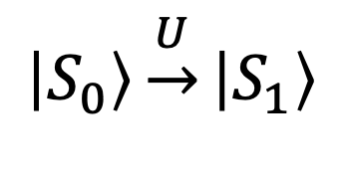


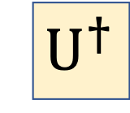


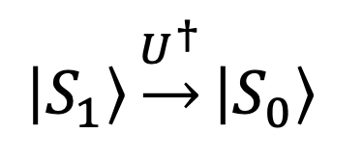
Reversibility of Quantum Operations
$$\left|S_{0}\right\rangle$$
$$\left|S_{0}\right\rangle$$
$$\left|S_{1}\right\rangle$$
$$U$$
$${ U}^{†}$$
$$\begin{matrix}\left|S_{0}\right\rangle \underset{→}{U}\left|S_{1}\right\rangle \end{matrix}$$
$$\begin{matrix}\left|S_{1}\right\rangle \underset{→}{U^{†}}\left|S_{0}\right\rangle \end{matrix}$$
$$U^{†}U=I$$
Notes:
An important property of quantum operations is that they are reversible. When a unitary operator is applied to a vector, it changes it position within the Bloch sphere. Applying its conjugate transpose will return the vector to its original state.
If the operator is Hermitian, it is equal to its conjugate transpose, meaning the same operator can perform the reverse operation.

Slide 9
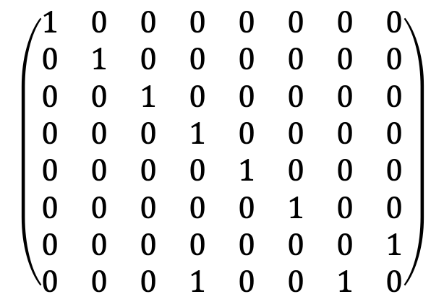
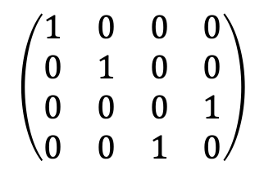
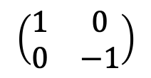
Quantum Gates by Number of Qubits
single-qubit
(~ 20 )
two-qubit
(~ 5 )
three-qubit
( ~ 2 )
$$\left(\begin{matrix}1 & 0 \\ 0 & −1\end{matrix}\right)$$
$$\left(\begin{matrix}1 & 0 & 0 & 0 \\ 0 & 1 & 0 & 0 \\ 0 & 0 & 0 & 1 \\ 0 & 0 & 1 & 0\end{matrix}\right)$$
$$\left(\begin{matrix}1 & 0 & 0 & 0 & 0 & 0 & 0 & 0 \\ 0 & 1 & 0 & 0 & 0 & 0 & 0 & 0 \\ 0 & 0 & 1 & 0 & 0 & 0 & 0 & 0 \\ 0 & 0 & 0 & 1 & 0 & 0 & 0 & 0 \\ 0 & 0 & 0 & 0 & 1 & 0 & 0 & 0 \\ 0 & 0 & 0 & 0 & 0 & 1 & 0 & 0 \\ 0 & 0 & 0 & 0 & 0 & 0 & 0 & 1 \\ 0 & 0 & 0 & 1 & 0 & 0 & 1 & 0\end{matrix}\right)$$
Notes:
Quantum gates are classified by how many qubits they act on: single-qubit, two-qubit, or three-qubit gates.
Single-qubit gates are represented by a 2×2 unitary matrix. Depending on the quantum processor, there are about 20 predefined single-qubit gates.
Two-qubit gates take two qubits as input and are represented by a 4×4 unitary matrix. There are about 5 predefined two-qubit gates.
Three-qubit gates take three qubits as input and are represented by an 8×8 unitary matrix. There are 2 predefined three-qubit gates.

Slide 10

Elementary quantum gates

Slide 11
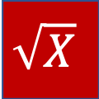
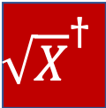
Library of Quantum Gates
Non-unitary operations
Pauli
Rotation
Phase
Other.
+
RX
P
I
Y
RY
S
H
|0⟩
Z
RZ
S†
$$\sqrt{X}$$
T
$${\sqrt{X}}^{†}$$
T†
U
Notes:
Quantum gates can generally be grouped into Pauli, rotation, phase, and other gates. There are also non-unitary operations, such as measurement and reset.
Each gate corresponds to an instruction in quantum assembly language. The table can therefore be viewed as a set of basic quantum instructions, where the label inside each gate symbol usually indicates the name of the gate.

Slide 12

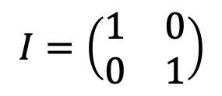
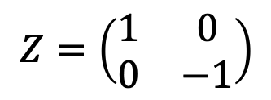

Pauli Gates: X,Y,Z
symbol
operator
description
QASM
I
$$\begin{matrix}I=\left(\begin{matrix}1 & 0 \\ 0 & 1\end{matrix}\right)\end{matrix}$$
Identity transformation.
id q[i];
+
$$\begin{matrix}X=\left(\begin{matrix}0 & 1 \\ 1 & 0\end{matrix}\right)\end{matrix}$$
Bit-flip gate; rotates the qubit by π about the x-axis, mapping z→−z.
x q[i];
X
Y
$$Y=\left(\begin{matrix}0 & −i \\ i & 0\end{matrix}\right)$$
Bit-phase-flip gate; rotates the qubit by π about the y-axis, mapping x→−x and z→−z.
y q[i];
Z
$$Z=\left(\begin{matrix}1 & 0 \\ 0 & −1\end{matrix}\right)$$
Phase-flip gate; rotates the qubit by π about the z-axis, mapping x→−x.
z q[i];
Notes:
The table lists the Pauli gates, which are fundamental single-qubit operations in quantum computing. Each gate is represented by its symbol, transformation matrix, and quantum assembly instruction.
Gate names are written in uppercase letters, while the corresponding matrices are denoted by the same letters in italic.
The assembly instruction, shown on the right, uses the gate name in lowercase, followed by the qubit name and its index.

Slide 13
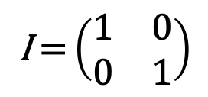
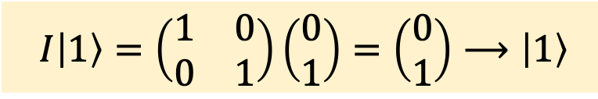
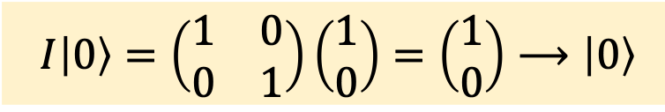
Identity Gate
symbol
operator
description
QASM
Applies the identity transformation, leaving the qubit unchanged while introducing a time delay, typically in the nanosecond range.
I
$$\text{I} \text{=}\left(\begin{matrix}\text{1} & \text{0} \\ 0 & \text{1}\end{matrix}\right)$$
id q[i];
$$I\left|0\right\rangle =\left(\begin{matrix}\text{1} & \text{0} \\ 0 & \text{1}\end{matrix}\right)\left(\begin{matrix}1 \\ 0\end{matrix}\right)=\left(\begin{matrix}1 \\ 0\end{matrix}\right)⟶\left|0\right\rangle$$
$$I\left|1\right\rangle =\left(\begin{matrix}\text{1} & \text{0} \\ 0 & \text{1}\end{matrix}\right)\left(\begin{matrix}0 \\ 1\end{matrix}\right)=\left(\begin{matrix}0 \\ 1\end{matrix}\right)⟶\left|1\right\rangle$$
Notes:
The Identity gate applies the identity transformation, leaving the qubit state unchanged. It can be compared to a NOP (no-operation) instruction in classical computing. On real quantum hardware, an Identity gate may occupy a short amount of execution time.
The Identity gate is represented by a square symbol with the letter I in the centre.
Its operator is the identity matrix, which leaves a state vector unchanged when multiplied by it.
The corresponding quantum assembly instruction is id, followed by the qubit name and its index.

Slide 14
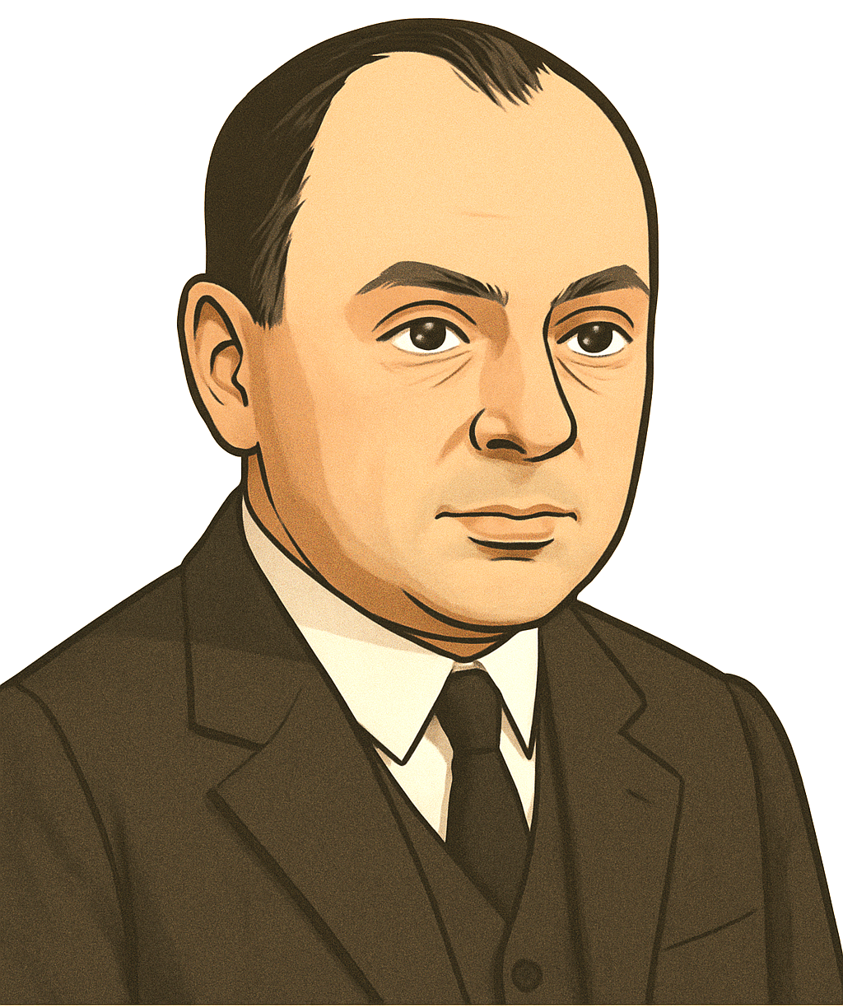
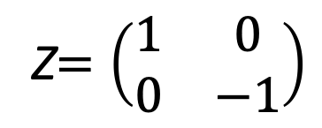
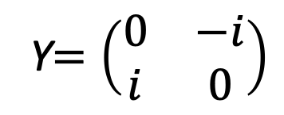
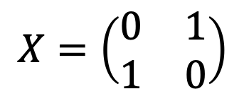
Pauli-X, Pauli-Y and Pauli-Z gates
Wolfgang Pauli
(1900–1958)
+
Y
Z
$$X=\left(\begin{matrix}0 & 1 \\ 1 & 0\end{matrix}\right)$$
Y$=\left(\begin{matrix}0 & −i \\ i & 0\end{matrix}\right)$
Z$=\left(\begin{matrix}1 & 0 \\ 0 & −1\end{matrix}\right)$
z
z
z
Notes:
The Pauli-X, Pauli-Y, and Pauli-Z gates are based on the Pauli matrices, introduced by physicist Wolfgang Pauli in 1927. These matrices are both unitary and Hermitian, meaning that applying the same gate twice returns the qubit to its original state. They are fundamental building blocks in quantum computing.
Pauli-X, or X gate, rotates a qubit by π radians (180°) about the x-axis of the Bloch sphere, swapping the probability amplitudes of ∣0⟩ and ∣1⟩. It acts as a quantum NOT gate.
Pauli-Y or Y gate rotates a qubit by π radians about the y-axis of the Bloch sphere, swapping the probability amplitudes of ∣0⟩ and ∣1⟩ while adding a phase shift of ±𝑖.
Pauli-Z or Z gate): Rotates a qubit by π radians about the z-axis of the Bloch sphere, flipping the phase of the ∣1⟩ state while leaving ∣0⟩ unchanged.

Slide 15
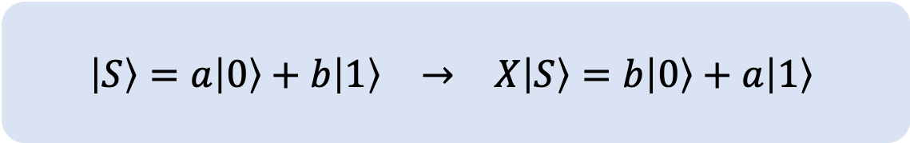
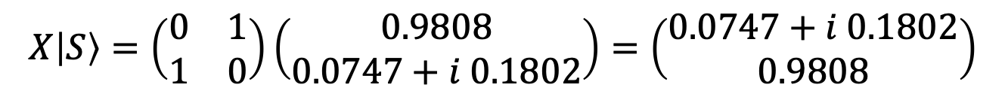
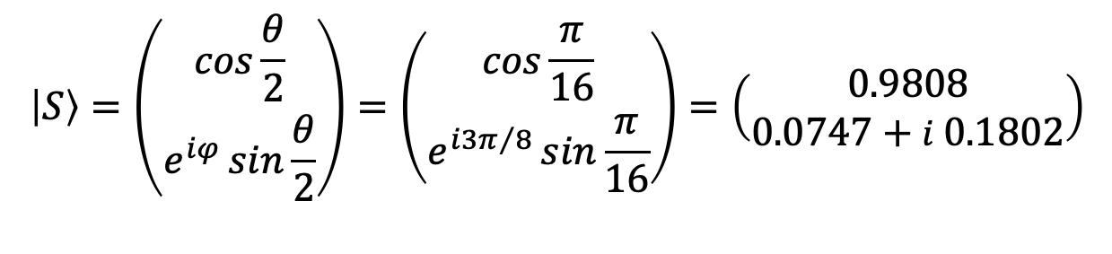
Pauli X Gate / NOT Gate
$$\left|S\right\rangle =\left(\begin{matrix}\cos{\frac{θ}{2}} \\ e^{iφ}\sin{\frac{θ}{2}}\end{matrix}\right)=\left(\begin{matrix}\cos{\frac{π}{16}} \\ e^{i3π/8}\sin{\frac{π}{16}}\end{matrix}\right)=\left(\begin{matrix}0.9808 \\ 0.0747+i 0.1802\end{matrix}\right)$$
$$X\left|S\right\rangle =\left(\begin{matrix}0 & 1 \\ 1 & 0\end{matrix}\right)\left(\begin{matrix}0.9808 \\ 0.0747+i 0.1802\end{matrix}\right)=\left(\begin{matrix}0.0747+i 0.1802 \\ 0.9808\end{matrix}\right)$$
$$\begin{matrix}\left|S\right\rangle =a\left|0\right\rangle +b\left|1\right\rangle & → & X\left|S\right\rangle =b\left|0\right\rangle +a\left|1\right\rangle \end{matrix}$$
Notes:
The Pauli-X gate, also called the NOT gate, acts as a bit-flip operator, interchanging the probability amplitudes of ∣0⟩ and ∣1⟩ while preserving their magnitudes.
For example, consider a quantum state ∣S⟩ defined by the angles θ = π/8 and φ = 3π/8 on the Bloch sphere.
When we apply the Pauli-X gate by multiplying it with the state ∣S⟩, we observe that it swaps the probability amplitudes of ∣0⟩ and ∣1⟩, which corresponds to a π-radian (180°) rotation about the x-axis of the Bloch sphere.
Mathematically, applying the Pauli-X gate transforms the state as:
$$\begin{matrix}\left|S\right\rangle =a\left|0\right\rangle +b\left|1\right\rangle & into & X\left|S\right\rangle =b\left|0\right\rangle +a\left|1\right\rangle \end{matrix}$$

Slide 16
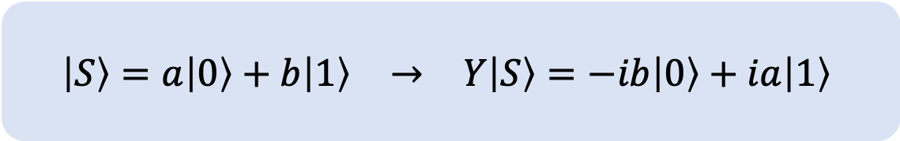
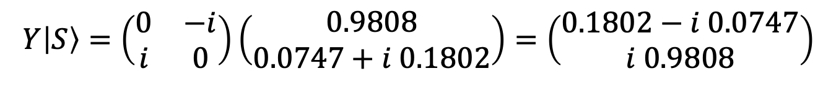
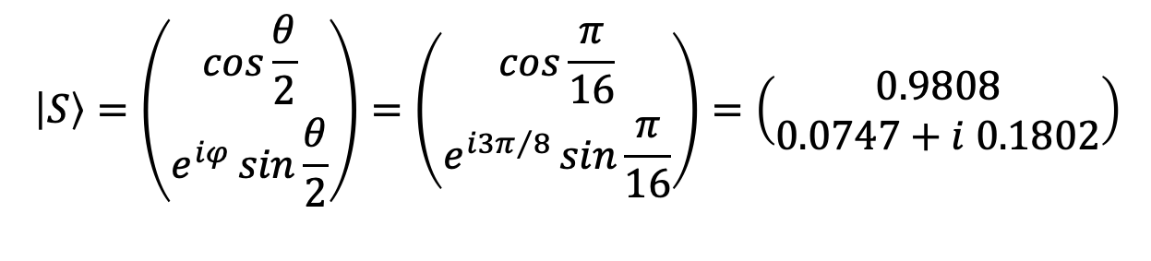
Pauli Y Gate
$$\left|S\right\rangle =\left(\begin{matrix}\cos{\frac{θ}{2}} \\ e^{iφ}\sin{\frac{θ}{2}}\end{matrix}\right)=\left(\begin{matrix}\cos{\frac{π}{16}} \\ e^{i3π/8}\sin{\frac{π}{16}}\end{matrix}\right)=\left(\begin{matrix}0.9808 \\ 0.0747+i 0.1802\end{matrix}\right)$$
$$Y\left|S\right\rangle =\left(\begin{matrix}0 & −i \\ i & 0\end{matrix}\right)\left(\begin{matrix}0.9808 \\ 0.0747+i 0.1802\end{matrix}\right)=\left(\begin{matrix}0.1802−i 0.0747 \\ i 0.9808\end{matrix}\right)$$
$$\begin{matrix}\left|S\right\rangle =a\left|0\right\rangle +b\left|1\right\rangle & → & Y\left|S\right\rangle =−ib\left|0\right\rangle +ia\left|1\right\rangle \end{matrix}$$
Notes:
The Pauli-Y gate acts as both a bit-flip and a phase-flip operator, interchanging the amplitudes of ∣0⟩ and ∣1⟩ while introducing phase factors of ±i.
Consider the same state ∣S⟩ defined by the angles θ = π/8 and φ = 3π/8 on the Bloch sphere.
Applying the Pauli-Y gate swaps the amplitudes of ∣0⟩ and ∣1⟩ and introduces phase factors of ±i. On the Bloch sphere, this corresponds to a π-radian (180∘) rotation about the y-axis.
Mathematically, applying the Pauli-Y gate transforms the state as:
$$\begin{matrix}\left|S\right\rangle =a\left|0\right\rangle +b\left|1\right\rangle & into & Y\left|S\right\rangle =−ib\left|0\right\rangle +ia\left|1\right\rangle \end{matrix}$$

Slide 17
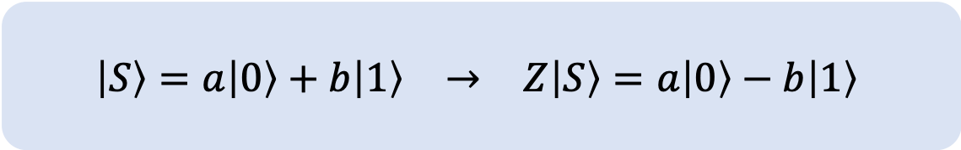
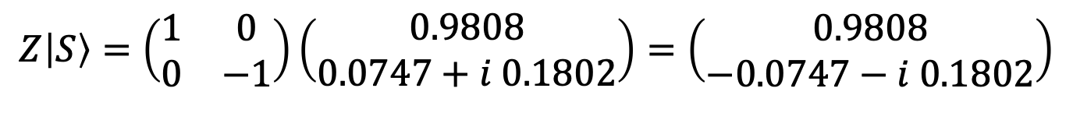
Pauli Z Gate
$$\left|S\right\rangle =\left(\begin{matrix}\cos{\frac{θ}{2}} \\ e^{iφ}\sin{\frac{θ}{2}}\end{matrix}\right)=\left(\begin{matrix}\cos{\frac{π}{16}} \\ e^{i3π/8}\sin{\frac{π}{16}}\end{matrix}\right)=\left(\begin{matrix}0.9808 \\ 0.0747+i 0.1802\end{matrix}\right)$$
$$Z\left|S\right\rangle =\left(\begin{matrix}1 & 0 \\ 0 & −1\end{matrix}\right)\left(\begin{matrix}0.9808 \\ 0.0747+i 0.1802\end{matrix}\right)=\left(\begin{matrix}0.9808 \\ −0.0747−i 0.1802\end{matrix}\right)$$
$$\begin{matrix}\left|S\right\rangle =a\left|0\right\rangle +b\left|1\right\rangle & → & Z\left|S\right\rangle =a\left|0\right\rangle −b\left|1\right\rangle \end{matrix}$$
Notes:
The Pauli-Z gate acts as a phase-flip operator, leaving the ∣0⟩ state unchanged while flipping the phase of the ∣1⟩ state.
Consider the same state ∣S⟩ defined by the angles θ = π/8 and φ = 3π/8 on the Bloch sphere.
When we apply the Pauli-Z gate by multiplying it with the state ∣S⟩, we observe that the amplitude of ∣0⟩ remains the same, while the amplitude of ∣1⟩ gains a phase factor of −1. This corresponds to a π-radian (180°) rotation about the z-axis of the Bloch sphere.
Mathematically, applying the Pauli-Z gate transforms the state as:
$$\begin{matrix}\left|S\right\rangle =a\left|0\right\rangle +b\left|1\right\rangle & into & Z\left|S\right\rangle =a\left|0\right\rangle −b\left|1\right\rangle \end{matrix}$$

Slide 18
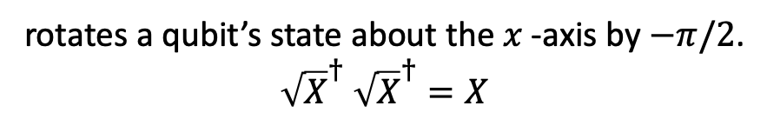
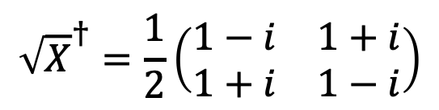

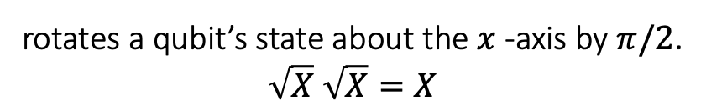
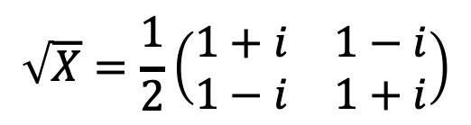
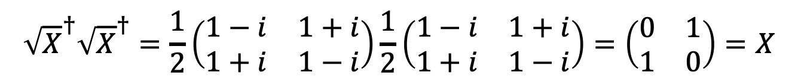

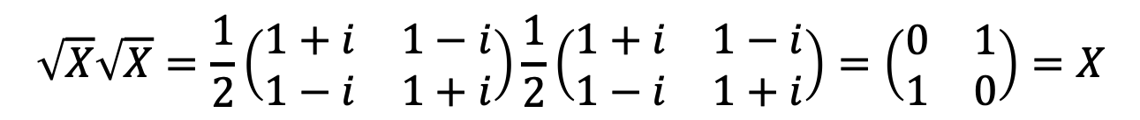
Square Root of X Gate
symbol
operator
description
QASM
$$\sqrt{X}$$
$$\begin{matrix}\sqrt{X}=\frac{1}{2}\left(\begin{matrix}1+i & 1−i \\ 1−i & 1+i\end{matrix}\right)\end{matrix}$$
rotates a qubit’s state about the $x$-axis by $π/2$.
$\sqrt{X}$ $\sqrt{X}=X$
sx q[i];
$${\sqrt{X}}^{†}$$
$${\sqrt{X}}^{†}=\frac{1}{2}\left(\begin{matrix}1−i & 1+i \\ 1+i & 1−i\end{matrix}\right)$$
rotates a qubit’s state about the $x$-axis by $−π/2$.
${\sqrt{X}}^{†}$ ${\sqrt{X}}^{†}=X$
sxdg q[i];
$$\sqrt{X}\sqrt{X}=\frac{1}{2}\left(\begin{matrix}1+i & 1−i \\ 1−i & 1+i\end{matrix}\right)\frac{1}{2}\left(\begin{matrix}1+i & 1−i \\ 1−i & 1+i\end{matrix}\right)=\left(\begin{matrix}0 & 1 \\ 1 & 0\end{matrix}\right)=X$$
$${\sqrt{X}}^{†}{\sqrt{X}}^{†}=\frac{1}{2}\left(\begin{matrix}1−i & 1+i \\ 1+i & 1−i\end{matrix}\right)\frac{1}{2}\left(\begin{matrix}1−i & 1+i \\ 1+i & 1−i\end{matrix}\right)=\left(\begin{matrix}0 & 1 \\ 1 & 0\end{matrix}\right)=X$$
Notes:
The square root of X gate (√X) rotates a qubit’s state about the X-axis by π/2.
Its inverse, the X† gate, rotates it by −π/2.
Applying √X twice, or X† twice, results in the Pauli-X gate.
In QASM, the letter ‘s’ denotes a square root operation. The suffix ‘dg’ means dagger, which refers to the Hermitian conjugate (†).

Slide 19
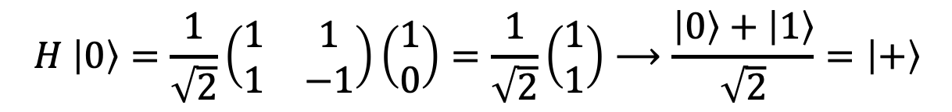

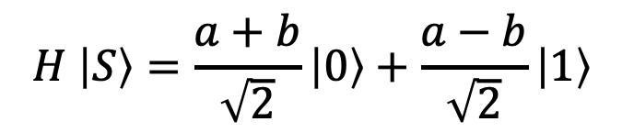
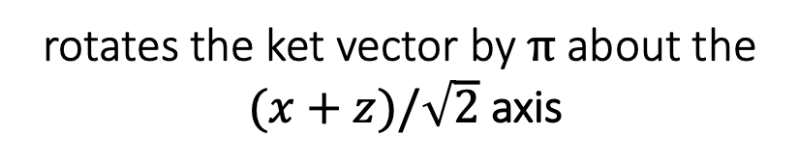

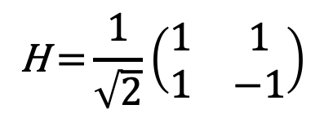
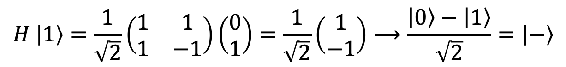
Hadamard Gate
symbol
operator
description
QASM
H
$$\text{H} \text{=}\frac{\text{1}}{\sqrt{\text{2}}}\left(\begin{matrix}\text{1} & \text{1} \\ \text{1} & \text{−1}\end{matrix}\right)$$
rotates the ket vector by $π$about the
$(x+z)/\sqrt{2}$ axis
h q[i];
$$\frac{x+z}{\sqrt{2}}$$
$$H \left|0\right\rangle =\frac{1}{\sqrt{2}}\left(\begin{matrix}1 & 1 \\ 1 & −1\end{matrix}\right)\left(\begin{matrix}1 \\ 0\end{matrix}\right)=\frac{1}{\sqrt{2}}\left(\begin{matrix}1 \\ 1\end{matrix}\right)⟶\frac{\left|0\right\rangle +\left|1\right\rangle }{\sqrt{2}}=\left|+\right\rangle$$
$$H \left|1\right\rangle =\frac{1}{\sqrt{2}}\left(\begin{matrix}1 & 1 \\ 1 & −1\end{matrix}\right)\left(\begin{matrix}0 \\ 1\end{matrix}\right)=\frac{1}{\sqrt{2}}\left(\begin{matrix}1 \\ −1\end{matrix}\right)⟶\frac{\left|0\right\rangle −\left|1\right\rangle }{\sqrt{2}}=\left|−\right\rangle$$
$$H \left|S\right\rangle =\frac{a+b}{\sqrt{2}}\left|0\right\rangle +\frac{a−b}{\sqrt{2}}\left|1\right\rangle$$
$$\left|S\right\rangle =a\left|0\right\rangle +b\left|1\right\rangle$$
Notes:
The Hadamard gate rotates the qubit state by 180∘ about an axis halfway between the x- and z-axes in the x-z plane of the Bloch sphere.
Multiplying the Hadamard matrix by |0⟩ results in |+⟩. In other words, the Hadamard gate places the |0⟩ state into an equal superposition of the computational basis states.
Similarly, when applied to |1⟩, the Hadamard gate produces |−⟩.
For a general qubit, the H gate combines its amplitudes into a new state: the amplitude of ∣0⟩ becomes their sum, while the amplitude of ∣1⟩ becomes their difference, with both scaled by $1/\sqrt{2}$.

Slide 20
Rotation and Phase Gates
20

Slide 21









Quantum Rotations
$$R_{x}$$
$$R_{y}$$
$$R_{z}$$
$$R_{x}\left(θ_{x}\right)=e^{−i\frac{θ_{x}}{2}X}$$
$$R_{y}\left(θ_{y}\right)=e^{−i\frac{θ_{y}}{2}Y}$$
$$R_{z}\left(θ_{z}\right)=e^{−i\frac{θ_{z}}{2}Z}$$
Notes:
By combining rotations about the $x$, $y$, and $z$ axes, a state vector can be moved to any point on the Bloch sphere. These rotations are performed by the rotation gates RX​, RY​, and RZ​, which are defined using the corresponding Pauli matrices X, Y, and Z.
A rotation by an angle θ is expressed as
$$R_{x}\left(θ_{x}\right)=e^{−i\frac{θ_{x}}{2}X}, R_{y}\left(θ_{y}\right)=e^{−i\frac{θ_{y}}{2}Y}, R_{z}\left(θ_{z}\right)=e^{−i\frac{θ_{z}}{2}Z}$$
Here, $X$, $Y$, and $Z$ are the corresponding Pauli matrices, and $θ$ is the amount of rotation. The factor $−θ/2$ in the exponential follows from the quantum-mechanical representation of rotations.

Slide 22










Deriving the RY Rotation Matrix
Euler's formula in matrix form ${ e}^{iθA}=\cos\left(θ\right)I+i\sin\left(θ\right)A$
$$z$$
$$\left|0\right\rangle$$
$R_{y}\left(θ\right)=e^{−i\frac{θ}{2}Y}$= $\cos\left(\frac{θ}{2}\right)I−i\sin\left(\frac{θ}{2}\right)Y$
$$π/2$$
$R_{y}\left(θ\right)$= $\cos\left(\frac{θ}{2}\right)\left(\begin{matrix}1 & 0 \\ 0 & 1\end{matrix}\right)−i\sin\left(\frac{θ}{2}\right)\left(\begin{matrix}0 & −i \\ i & 0\end{matrix}\right)$
$$=\left(\begin{matrix}\cos\left(\frac{θ}{2}\right) & −sin\left(\frac{θ}{2}\right) \\ \sin\left(\frac{θ}{2}\right) & \cos\left(\frac{θ}{2}\right)\end{matrix}\right)$$
$$y$$
$$x$$
$$R_{y}\left(\frac{π}{2}\right)=\left(\begin{matrix}\cos\left(\frac{π}{4}\right) & −sin\left(\frac{π}{4}\right) \\ \sin\left(\frac{π}{4}\right) & \cos\left(\frac{π}{4}\right)\end{matrix}\right){=\frac{\text{1}}{\sqrt{\text{2}}} \left(\begin{matrix}\text{1} & \text{−1} \\ \text{1} & \text{1}\end{matrix}\right)}$$
$$↺\frac{π}{2}$$
Notes:
As an example, consider a rotation about the y-axis. Starting with Euler’s formula in matrix form and using the Pauli-Y matrix, the rotation operator can be written as $R_{y}\left(θ\right)=e^{−i\frac{θ}{2}Y}$
Expanding this exponential using Euler’s formula gives the RY​(θ) rotation operator:
$$R_{y}\left(θ\right)=\cos\left(\frac{θ}{2}\right)\left(\begin{matrix}1 & 0 \\ 0 & 1\end{matrix}\right)−i\sin\left(\frac{θ}{2}\right)\left(\begin{matrix}0 & −i \\ i & 0\end{matrix}\right)=\left(\begin{matrix}\cos\left(\frac{θ}{2}\right) & −sin\left(\frac{θ}{2}\right) \\ \sin\left(\frac{θ}{2}\right) & \cos\left(\frac{θ}{2}\right)\end{matrix}\right)$$
This operator rotates the quantum state by an angle θ about the y-axis of the Bloch sphere.
For example, setting θ=π/2 rotates the qubit state by 90 degrees about the Y-axis of the Bloch sphere.

Slide 23



Parameterized Rotation Gates
symbol
operator
description
QASM
$$\begin{matrix}R_{x}=e^{−i\frac{θ}{2}X}=\left(\begin{matrix}cos\frac{θ}{2} & −i sin\frac{θ}{2} \\ −i sin\frac{θ}{2} & cos\frac{θ}{2}\end{matrix}\right)\end{matrix}$$
RX
Rotation about the 𝑥 -axis for a given angle.
rx(t) q[i];
$$\begin{matrix}R_{y}=e^{−i\frac{θ}{2}Y}=\left(\begin{matrix}cos\frac{θ}{2} & −sin\frac{θ}{2} \\ sin\frac{θ}{2} & cos\frac{θ}{2}\end{matrix}\right)\end{matrix}$$
RY
Rotation about the y -axis for a given angle.
ry(t) q[i];
$$\begin{matrix}R_{z}=e^{−i\frac{θ}{2}Z}=\left(\begin{matrix}e^{−i\frac{θ}{2}} & 0 \\ 0 & e^{i\frac{θ}{2}}\end{matrix}\right)\end{matrix}$$
RZ
Rotation about the z -axis for a given angle.
rz(t) q[i];
Notes:
Using the same method, we can construct rotation operators about the x-, y-, and z-axes for any angle. These are the standard rotation gates RX​, RY​, and RZ​.
They are parameterized gates, meaning that the rotation angle θ is specified as a parameter. In a quantum program, θ can be any real number, including values expressed in terms of π, such as θ=π/2.

Slide 24



Phase Shift Gates
$$\left\{\begin{matrix}Z=P\left(π\right) & = & \left(\begin{matrix}1 & 0 \\ 0 & −1\end{matrix}\right) \\ S=P\left(\frac{π}{2}\right) & = & \left(\begin{matrix}1 & 0 \\ 0 & i\end{matrix}\right) \\ S^{†}=P\left(\frac{−π}{2}\right) & = & \left(\begin{matrix}1 & 0 \\ 0 & −i\end{matrix}\right) \\ T=P\left(\frac{π}{4}\right) & = & \left(\begin{matrix}1 & 0 \\ 0 & e^{i\frac{π}{4}}\end{matrix}\right) \\ T^{†}=P\left(\frac{−π}{4}\right) & = & \left(\begin{matrix}1 & 0 \\ 0 & e^{−i\frac{π}{4}}\end{matrix}\right)\end{matrix}\right.$$
Z
S
$P\left(φ\right)=$ $\left(\begin{matrix}1 & 0 \\ 0 & e^{iφ}\end{matrix}\right)$
S†
T
P
T†
The phase gate rotates the state vector about the $z$–axis by an angle $φ$.
Notes:
In addition to rotation gates, there are also phase-shift gates, which change the relative phase of a qubit state. Phase-shift gates correspond to rotations of the quantum state about the z-axis of the Bloch sphere. The most general of these is the P gate, which takes a phase angle $φ$ as a parameter:
$$P\left(φ\right)=\left(\begin{matrix}1 & 0 \\ 0 & e^{iφ}\end{matrix}\right)$$
Choosing specific values of 𝜑, gives five other commonly used gates:
For 𝜑=𝜋, this gives the Pauli-Z gate.
For 𝜑=±𝜋/2 , this gives the S and S† gates.
For 𝜑=±𝜋/4, this gives theT and T† gates.

Slide 25








Phase Gates Summary
symbol
operator
description
QASM
P
$$P\text{=} \left(\begin{matrix}1 & 0 \\ 0 & e^{iφ}\end{matrix}\right)$$
rotation about the $z$–axis by an angle $φ$.
p(f) q[i];
S
$$\begin{matrix}S=\left(\begin{matrix}1 & 0 \\ 0 & i\end{matrix}\right)\end{matrix}$$
a 𝜋/2 rotation about the z-axis / maps x to y.
s q[i];
$$S^{†}=\left(\begin{matrix}1 & 0 \\ 0 & −i\end{matrix}\right)$$
S†
a -𝜋/2 rotation about the z-axis / maps x to -y.
sdg q[i];
T
$$T=\left(\begin{matrix}1 & 0 \\ 0 & e^{i\frac{π}{4}}\end{matrix}\right)$$
rotation about the $z$–axis by 𝜋/4
t q[i];
T†
$$T^{†}=\left(\begin{matrix}1 & 0 \\ 0 & e^{−i\frac{π}{4}}\end{matrix}\right)$$
rotation about the $z$–axis by -𝜋/4
tdg q[i];
Notes:
The table shows the standard phase-shift gates. Among them, only the P gate is parameterized, while the other gates have fixed phase angles. The S and T gates are not Hermitian, and their inverse operations are given by S† and T†, respectively.

Slide 26













The Universal Operator
$$R_{z}\left(λ\right)=\left(\begin{matrix}e^{−i\frac{λ}{2}} & 0 \\ 0 & e^{i\frac{λ}{2}}\end{matrix}\right)⟶$$
$R_{y}\left(θ\right)=\left(\begin{matrix}\cos{\frac{θ}{2}} & −\sin{\frac{θ}{2}} \\ \sin{\frac{θ}{2}} & \cos{\frac{θ}{2}}\end{matrix}\right)$ $⟶$
$$R_{z}\left(λ\right)=\left(\begin{matrix}e^{−i\frac{φ}{2}} & 0 \\ 0 & e^{i\frac{φ}{2}}\end{matrix}\right)$$
$$z$$
$$λ$$
$$U\left(θ,φ,λ\right)=R_{z}\left(φ\right)R_{y}\left(θ\right)R_{z}\left(λ\right)$$
$$φ$$
$$θ$$
$$\left|S\right\rangle$$
$\left|S′\right\rangle =U$ $\left|S\right\rangle$
$$U\left(θ,φ,λ\right) =\left(\begin{matrix}\cos{\frac{θ}{2}} & −e^{iλ}\sin{\frac{θ}{2}} \\ e^{iφ}\sin{\frac{θ}{2}} & e^{i(λ+φ)}\cos{\frac{θ}{2}}\end{matrix}\right)$$
$$y$$
$$x$$
Notes:
Any rotation of a qubit state on the Bloch sphere can be performed using three rotations about two different axes. This means that a state vector can be moved to an arbitrary point on the Bloch sphere by performing three consecutive rotations:
by $λ$ about the z-axis,
by $θ$ about the y-axis,
and by $φ$ about the z-axis again.
This is written as:
$$U\left(θ,φ,λ\right)=R_{z}\left(φ\right)R_{y}\left(θ\right)R_{z}\left(λ\right)$$
This gives us a universal single-qubit gate, meaning that any single-qubit unitary operation can be expressed in this form using the angles$θ$, $φ$, and $λ$, up to a global phase. In real quantum computers, compilers use this decomposition to break complex operations into rotation gates that hardware can run directly.
The phrase “up to a global phase” means that the expression $R_{z}\left(φ\right)R_{y}\left(θ\right)R_{z}\left(λ\right)$ can reproduce any single-qubit unitary transformation, although the resulting matrix may differ from the desired matrix by an overall phase factor $e^{iγ}$
$$U={e^{iγ}R}_{z}\left(φ\right)R_{y}\left(θ\right)R_{z}\left(λ\right)$$
Since a global phase has no observable effect, the two transformations are physically equivalent.

Slide 27


Universal Single-Qubit Gate
symbol
operator
QASM
$$U=\left(\begin{matrix}\cos{\frac{θ}{2}} & {−e}^{iλ}\sin{\frac{θ}{2}} \\ e^{iφ}\sin{\frac{θ}{2}} & e^{i(λ+φ)}\cos{\frac{θ}{2}}\end{matrix}\right)$$
U
u(t,p,l) q[i];
The gate parameters are three rotation angles:
$λ$: rotation about the $z$-axis
$φ$: rotation about the $z$-axis
$θ$: rotation about the$y$-axis
description
Notes:
The universal gate $U\left(θ,φ,λ\right)$, can represent any single-qubit operation simply by adjusting its three parameters.
Quantum compilers can express arbitrary single-qubit gates in the form $U\left(θ,φ,λ\right)$ and then map this representation to the native gates supported by the quantum hardware.

Slide 28









Measurement Operation (Gate)
Measurement in the
standard (Z) basis.
measure q[i]->c[j]
c[i] = measure q[j]
$$\left|0\right\rangle$$
$$\left|0\right\rangle$$
$$\left|1\right\rangle$$
$$\left|1\right\rangle$$
$$0$$
$$1$$
$$\left|0\right\rangle$$
$$0.6\left|0\right\rangle +0.8\left|1\right\rangle$$
0 (36%)
1 (64%)
$$\left|1\right\rangle$$
Notes:
Measuring, or reading, a qubit is performed using a measurement operation, often represented by a measurement-gate symbol. This operation is irreversible: once a qubit is measured, its state collapses to a basis state, and the original superposition cannot be recovered.
In quantum computing, measurement is typically performed in the computational (standard) basis, {∣0⟩, ∣1⟩}. and is called standard measurement. The possible measurement outcomes are the classical bits 0 and 1, leaving the measured qubit in the corresponding state ∣0⟩ or ∣1⟩.
If the qubit is in state ∣0⟩, measurement always produces bit 0, and the qubit remains in ∣0⟩.
If the qubit is in state ∣1⟩, measurement always produces bit 1, and the qubit remains in ∣1⟩.
If the qubit is in a superposition of ∣0⟩ and ∣1⟩, the measurement outcome is random, with probabilities determined by Born’s rule. After measurement, the qubit is in ∣0⟩ or ∣1⟩, corresponding to the measured classical bit.
Measurement therefore marks the transition from a quantum state to a definite classical measurement outcome.

Slide 29
User-defined quantum gates
gate name (param_1,param_2,...) qarg_1,qarg_2,... {
// gate instructions
}
name the name of the custom gate.
param an optional list of input parameters, such as rotation angles.
qarg one or more qubits that serve as temporary arguments for the gate operation.
Notes:
OpenQASM allows programmers to define custom quantum gates using the gate statement. The syntax is similar to a function definition in a high-level programming language, with parameters and qubit arguments.
gate name(param) qarg { ... }
name – Specifies the name of the custom gate.
param – Specifies an optional list of parameters, such as rotation angles.
qarg – Specifies one or more qubit arguments on which the gate operates.
This feature enables modular and reusable gate definitions, making quantum circuits easier to structure and understand.

Slide 30

Superconducting Quantum Processing Unit (QPU)
quantum gate:
microwave pulse
measuring/readout resonator
Notes:
In a superconducting quantum processor, precisely shaped microwave pulses are sent to the resonators that control the qubits. Microwave resonators are also used to read the qubit states and, in some architectures, to help qubits interact and become entangled. In the figure, green resonators are used for qubit control, while blue resonators are used for qubit readout.
The control electronics generate microwave pulses with specific frequency, amplitude, phase, and duration. By adjusting these properties, different quantum operations can be performed on the qubits. Some operations, such as Z-axis rotations, can be implemented virtually without sending an additional microwave pulse.
A readout resonator is used to measure the state of a qubit. A weak microwave signal is sent to the resonator, and its response depends on the qubit state. By analyzing the returned signal, the system determines whether the measured qubit is in state ∣0⟩ or ∣1⟩. The measurement is designed to be quantum non-demolition (QND), meaning that after measurement the qubit ideally remains in the measured state. For example, if the result is 0, the qubit remains in state ∣0⟩, so an immediate second measurement should give the same result.

Slide 31


Two-Qubit Gates

Slide 32


Controlled Gates
Pauli
Rotation
Phase
Other.
control (c_{k})
+
RX
P
I
Y
RY
S
H
Z
RZ
S†
$$\sqrt{X}$$
T
$${\sqrt{X}}^{†}$$
T†
U
target (t)
Notes:
A unitary gate can be extended to a controlled gate by adding one or more control qubits. By convention, a control qubit is labelled c, and a target qubit, on which the gate acts, is labelled t.
A controlled gate can be thought of as the quantum equivalent of an if statement:
IF the control condition is satisfied, THEN apply the gate to the target qubit(s).
The control condition for a single control qubit can be defined as state ∣1⟩, indicated by a black circle (●), or state ∣0⟩, indicated by a white circle (○). For example, if all controls are indicated by black circles, the gate is applied only when all control qubits are in state ∣1⟩.

Slide 33


Controlled Gate Transformation Matrix
INPUT $$\left|\text{c} \text{t} \right\rangle$$ | OUTPUT $$\left|\text{c} t \right\rangle$$
$$\left|\text{0}0\right\rangle$$ | $$\left|\text{0}\text{0}\right\rangle$$ | $$\left(\begin{matrix}1 \\ 0 \\ 0 \\ 0\end{matrix}\right)$$
$$\left|\text{0}\text{1}\right\rangle$$ | $$\left|\text{0}\text{1}\right\rangle$$ | $$\left(\begin{matrix}0 \\ 1 \\ 0 \\ 0\end{matrix}\right)$$
$$\left|\text{10}\right\rangle$$ | $$\left|\text{1}\right\rangle ⨂G\left|\text{0}\right\rangle$$ | $$\left(\begin{matrix}0 \\ 0 \\ g_{00} \\ g_{10}\end{matrix}\right)$$
$$\left|\text{11}\right\rangle$$ | $$\left|\text{1}\right\rangle ⨂G\left|\text{1}\right\rangle$$ | $$\left(\begin{matrix}0 \\ 0 \\ g_{01} \\ g_{11}\end{matrix}\right)$$
OUTPUT
$$\left(\begin{matrix}1 \\ 0 \\ 0 \\ 0\end{matrix}\right)$$
$$\left(\begin{matrix}0 \\ 1 \\ 0 \\ 0\end{matrix}\right)$$
$$\left(\begin{matrix}0 \\ 1\end{matrix}\right)⨂\left(\begin{matrix}g_{00} & g_{01} \\ g_{10} & g_{11}\end{matrix}\right)\left(\begin{matrix}1 \\ 0\end{matrix}\right)=\left(\begin{matrix}0 \\ 0 \\ g_{00} \\ g_{10}\end{matrix}\right)$$
$$\left(\begin{matrix}0 \\ 1\end{matrix}\right)⨂\left(\begin{matrix}g_{00} & g_{01} \\ g_{10} & g_{11}\end{matrix}\right)\left(\begin{matrix}0 \\ 1\end{matrix}\right)=\left(\begin{matrix}0 \\ 0 \\ g_{01} \\ g_{11}\end{matrix}\right)$$
$$c$$
$$I$$
$$\begin{matrix}cG=\left(\begin{matrix}1 & 0 & 0 & 0 \\ 0 & 1 & 0 & 0 \\ 0 & 0 & g_{00} & g_{01} \\ 0 & 0 & g_{10} & g_{11}\end{matrix}\right)\end{matrix}$$
$$t$$
G
$$G=\left(\begin{matrix}g_{00} & g_{01} \\ g_{10} & g_{11}\end{matrix}\right)$$
$$G$$
Notes:
The transformation matrix for a controlled operator can be derived using an arbitrary single-qubit gate G. The gate G acts on the target qubit t only when the control qubit c is in the state ∣1⟩.
The slide shows the transformation of the four basis states in Dirac notation, with the first qubit as the control and the second as the target:
For ∣00⟩: the control is ∣0⟩, so the state remains ∣00⟩.
For ∣01⟩: the control is ∣0⟩, so the state remains ∣01⟩.
For ∣10⟩: the control is ∣1⟩, so G is applied to the target ∣0⟩, giving ∣1⟩⊗G∣0⟩.
For ∣11⟩: the control is ∣1⟩, so G is applied to the target ∣1⟩, giving ∣1⟩⊗G∣1⟩.
After writing these outputs in matrix form and carrying out the multiplications, we obtain the corresponding output vectors.
Placing these column vectors side by side gives the matrix of the two-qubit controlled operator.
The resulting matrix has a block-diagonal form: the upper block is the identity matrix $I$, and the lower block is the gate matrix $G$.
To obtain a controlled version of a particular gate, simply replace G with the corresponding single-qubit operator, such as X, Y, or Z. A leading C commonly denotes the controlled version, giving, for example, CX, CY, or CZ.

Slide 34

CX / CNOT gate
symbol
operator
description
QASM
$$c$$
CX applies the X gate to the target qubit (t) when the control qubit (c) is ∣1⟩.
$$CX=\left(\begin{matrix}1 & 0 & 0 & 0 \\ 0 & 1 & 0 & 0 \\ 0 & 0 & 0 & 1 \\ 0 & 0 & 1 & 0\end{matrix}\right)$$
cx q[0], q[1];
$$t$$
+
$$\text{c} \text{t}$$ | $$c ⨁ t$$
$$\left|\text{0}0\right\rangle$$ | $$\left|\text{0}\right\rangle$$
$$\left|\text{0}\text{1}\right\rangle$$ | $$\left|\text{1}\right\rangle$$
$$\left|\text{10}\right\rangle$$ | $$\left|\text{1}\right\rangle$$
$$\left|\text{11}\right\rangle$$ | $$\left|0\right\rangle$$
$$c⨁t=\left\{\begin{matrix}0+0=0 \\ 0+1=1 \\ 1+0=1 \\ 1+1=0\end{matrix}\right.$$
$$\left|c\right\rangle$$
$$\left|c\right\rangle$$
+
$$\left|t\right\rangle$$
$$\left|c⨁t\right\rangle$$
Notes:
The most common controlled gate is the controlled Pauli-X gate, usually called CX or CNOT.
By definition, if the control qubit is ∣1⟩, the X gate is applied to the target qubit. If the control qubit is ∣0⟩, the target remains unchanged. Its matrix is a 4×4 block-diagonal matrix, with the identity matrix I in the upper block and the Pauli-X matrix in the lower block.
The CNOT gate can also be understood as performing an XOR operation, or equivalently addition modulo 2, on the target qubit. The control qubit remains unchanged.

Slide 35
Controlled Pauli Gates
symbol
operator
description
QASM
$$c$$
$$cX=\left|0\right\rangle \left\langle 0\right|⨂I+\left|1\right\rangle \left\langle 1\right|⨂X$$
$$\left(\begin{matrix}1 & 0 & 0 & 0 \\ 0 & 1 & 0 & 0 \\ 0 & 0 & 0 & 1 \\ 0 & 0 & 1 & 0\end{matrix}\right)$$
CX applies the X gate to the target qubit (t) when the control qubit (c) is ∣1⟩.
cx q[0], q[1];
$$t$$
+
$$c$$
$$cY=\left|0\right\rangle \left\langle 0\right|⨂I+\left|1\right\rangle \left\langle 1\right|⨂Y$$
CY applies the Y gate to the target qubit (t) when the control qubit (c) is ∣1⟩.
$$cY=\left(\begin{matrix}1 & 0 & 0 & 0 \\ 0 & 1 & 0 & 0 \\ 0 & 0 & 0 & −i \\ 0 & 0 & i & 0\end{matrix}\right)$$
$$t$$
cy q[0], q[1];
Y
$$c$$
$$cZ=\left|0\right\rangle \left\langle 0\right|⨂I+\left|1\right\rangle \left\langle 1\right|⨂Z$$
CZ applies the Z gate to the target qubit (t) when the control qubit (c) is ∣1⟩.
$$cZ=\left(\begin{matrix}1 & 0 & 0 & 0 \\ 0 & 1 & 0 & 0 \\ 0 & 0 & 1 & 0 \\ 0 & 0 & 0 & −1\end{matrix}\right)$$
$$t$$
cz q[0], q[1];
Z
Notes:
Just like the Pauli-X gate, the other Pauli operators can also be turned into controlled gates by adding a control qubit. In this case, the chosen Pauli operation is applied to the target qubit only when the control qubit is in state ∣1⟩.
The Z gate applies a phase factor of −1 to the ∣1⟩ state. Therefore, the CZ gate applies a phase factor of −1 only to the ∣11⟩ state: ∣10⟩→∣10⟩ and ∣11⟩→−∣11⟩. In other words, the CZ gate changes the phase only when both qubits are in the ∣1⟩ state, leaving the other computational-basis states unchanged.

Slide 36

Controlled Hadamard Gate / CH
symbol
operator
description
QASM
C$H=\left|0\right\rangle \left\langle 0\right|⨂I+\left|1\right\rangle \left\langle 1\right|⨂H$
$$c$$
CH applies the H gate to the target qubit (t) when the control qubit (c) is ∣1⟩.
$$cH=\left(\begin{matrix}1 & 0 & 0 & 0 \\ 0 & 1 & 0 & 0 \\ 0 & 0 & \frac{1}{\sqrt{2}} & \frac{1}{\sqrt{2}} \\ 0 & 0 & \frac{1}{\sqrt{2}} & −\frac{1}{\sqrt{2}}\end{matrix}\right)$$
ch q[0], q[1];
$$t$$
H
Notes:
In the same way, we can define a controlled-Hadamard, or CH, gate. Here, the Hadamard transformation is applied to the target qubit only when the control qubit is in state ∣1⟩. The CH gate is useful when we want to apply the Hadamard transformation, and potentially create a superposition, only under a certain condition.

Slide 37
Controlled Phase Gate / CP
symbol
operator
description
QASM
$$cP=\left|0\right\rangle \left\langle 0\right|⨂I+\left|1\right\rangle \left\langle 1\right|⨂P$$
The CP gate applies a phase $e^{iλ}$ to the $\left|11\right\rangle$ state while leaving other states unchanged.
$$c$$
$$cP=\left(\begin{matrix}1 & 0 & 0 & 0 \\ 0 & 1 & 0 & 0 \\ 0 & 0 & 1 & 0 \\ 0 & 0 & 0 & e^{iλ}\end{matrix}\right)$$
cp(l) q[i],q[j];
$$t$$
P
$\left|00\right\rangle →$ $\left|00\right\rangle$
$\left|01\right\rangle →$ $\left|01\right\rangle$
$\left|10\right\rangle →$ $\left|10\right\rangle$
$\left|11\right\rangle →$ $e^{iλ} \left|11\right\rangle$
Notes:
The controlled-phase gate applies a phase shift to the target qubit only when the control qubit is in state ∣1⟩.
The gate is symmetric, so swapping the control and target qubits does not change its operation. This is because the phase factor $e^{iλ}$ is applied only to the ∣11⟩ state, while all other computational basis states remain unchanged.

Slide 38
Controlled Rotation Gates
RX
RY
RZ
$$\left|0\right\rangle \left\langle 0\right|⨂I+\left|1\right\rangle \left\langle 1\right|⨂Rx(θ)$$
$$\left|0\right\rangle \left\langle 0\right|⨂I+\left|1\right\rangle \left\langle 1\right|⨂Ry(θ)$$
$$\left|0\right\rangle \left\langle 0\right|⨂I+\left|1\right\rangle \left\langle 1\right|⨂Rz(λ)$$
$$\left(\begin{matrix}1 & 0 & 0 & 0 \\ 0 & 1 & 0 & 0 \\ 0 & 0 & \cos{\frac{θ}{2}} & −i sin{\frac{θ}{2}} \\ 0 & 0 & −i sin{\frac{θ}{2}} & \cos{\frac{θ}{2}}\end{matrix}\right)$$
$$\left(\begin{matrix}1 & 0 & 0 & 0 \\ 0 & 1 & 0 & 0 \\ 0 & 0 & \cos{\frac{θ}{2}} & − sin{\frac{θ}{2}} \\ 0 & 0 & \sin{\frac{θ}{2}} & \cos{\frac{θ}{2}}\end{matrix}\right)$$
$$\left(\begin{matrix}1 & 0 & 0 & 0 \\ 0 & 1 & 0 & 0 \\ 0 & 0 & e^{−i\frac{λ}{2}} & 0 \\ 0 & 0 & 0 & e^{i\frac{λ}{2}}\end{matrix}\right)$$
crx(t) q[i],q[j];
cry(t) q[i],q[j];
crz(l) q[i],q[j];
Notes:
Controlled rotation gates CRX​, CRY​, and CRZ​ rotate the target qubit about the x-, y-, or z-axis by a chosen angle when the control qubit is in state ∣1⟩. Controlled rotations provide a finer level of control over quantum states and are often used in parameterized quantum circuits, particularly in quantum machine learning.

Slide 39

SWAP gate
symbol
operator
description
QASM
$$\left|\text{a}\right\rangle$$
$$\left|\text{b}\right\rangle$$
Exchanges the states of two qubits:
$$SWAP=\left(\begin{matrix}1 & 0 & 0 & 0 \\ 0 & 0 & 1 & 0 \\ 0 & 1 & 0 & 0 \\ 0 & 0 & 0 & 1\end{matrix}\right)$$
swap q[i], q[j];
$$\left|\text{b}\right\rangle$$
$$\left|\text{a}\right\rangle$$
$$\left|\text{ab}\right\rangle →\left|\text{ba}\right\rangle$$
$$in$$ | $$out$$
$$\left|\text{00}\right\rangle$$ | $$\left|\text{00}\right\rangle$$
$$\left|\text{0}\text{1}\right\rangle$$ | $$\left|\text{10}\right\rangle$$
$$\left|\text{10}\right\rangle$$ | $$\left|\text{0}\text{1}\right\rangle$$
$$\left|\text{11}\right\rangle$$ | $$\left|\text{1}1\right\rangle$$
Notes:
The SWAP gate exchanges the states of two qubits. If the input is ∣ab⟩, the output becomes ∣ba⟩.

Slide 40
Controlled U gate
symbol
description
$$cU(θ,φ,λ,γ)\left|0\right\rangle \left\langle 0\right|⨂I+e^{iγ}\left|1\right\rangle \left\langle 1\right|⨂U(θ,φ,λ)$$
$$c$$
$$cU(θ,φ,λ,γ)=\left(\begin{matrix}1 & 0 & 0 & 0 \\ 0 & 1 & 0 & 0 \\ 0 & 0 & e^{iγ}\cos{\frac{θ}{2}} & {−e}^{i(γ+λ)}\sin{\frac{θ}{2}} \\ 0 & 0 & e^{i(γ+φ)}\sin{\frac{θ}{2}} & e^{i(γ+φ+λ)}\cos{\frac{θ}{2}}\end{matrix}\right)$$
$$t$$
U
QASM
cu(t,p,l,g) q[i],q[j];
Notes:
The CU gate is the controlled version of the universal single-qubit gate. It applies the U transformation to the target qubit only when the control qubit is in state ∣1⟩. Since the U gate can represent a general single-qubit transformation, the CU gate provides a general form of a controlled single-qubit operation.
By choosing different angle values, the CU gate can reproduce many familiar controlled gates, such as CX, CY, and CZ.

Slide 41
Three-qubit gates
41

Slide 42






Toffoli / CCNOT / CCX gate
symbol
operator
QASM
$$c_{1}$$
$$\left|0\right\rangle \left\langle 0\right|⨂I⨂I+\left|1\right\rangle \left\langle 1\right|⨂cX$$
$$c_{2}$$
$$CCX=\left(\begin{matrix}1 & 0 & 0 & 0 & 0 & 0 & 0 & 0 \\ 0 & 1 & 0 & 0 & 0 & 0 & 0 & 0 \\ 0 & 0 & 1 & 0 & 0 & 0 & 0 & 0 \\ 0 & 0 & 0 & 1 & 0 & 0 & 0 & 0 \\ 0 & 0 & 0 & 0 & 1 & 0 & 0 & 0 \\ 0 & 0 & 0 & 0 & 0 & 1 & 0 & 0 \\ 0 & 0 & 0 & 0 & 0 & 0 & 0 & 1 \\ 0 & 0 & 0 & 1 & 0 & 0 & 1 & 0\end{matrix}\right)$$
ccx q[0],q[1],q[2];
$$t$$
+
$$t ⨁(c_{1}{∙c}_{2})$$
$$CCX=\left(\begin{matrix}I_{6} & 0 \\ 0 & X\end{matrix}\right)$$
Notes:
The CCNOT gate, also called the CCX or Toffoli gate, is named after Tommaso Toffoli, an Italian-American scientist who introduced it in the context of reversible computing before it was adopted in quantum computing.
The CCX gate works like an extended version of the controlled-X gate. Instead of one control qubit, it uses two. The X gate acts on the target qubit only when both control qubits are in state ∣1⟩. This can be written as $t^{′}=t ⨁(c_{1}{∙c}_{2})$, where ⋅ represents AND and ⊕ represents XOR. The two control qubits remain unchanged.
The CCX matrix has a block-diagonal structure. The first six computational basis states remain unchanged. When both control qubits are 1, the X operation acts on the target qubit, exchanging the states ∣110⟩ and ∣111⟩. Therefore, the matrix can be written as
$$CCX=\left(\begin{matrix}I_{6} & 0 \\ 0 & X\end{matrix}\right)$$

Slide 43


Fredkin/ CSWAP Gate
symbol
operator
QASM
c
$$cSWAP=\left|0\right\rangle \left\langle 0\right|⨂I⨂I+\left|1\right\rangle \left\langle 1\right|⨂SWAP$$
$$t_{1}$$
$$cSWAP=\left(\begin{matrix}1 & 0 & 0 & 0 & 0 & 0 & 0 & 0 \\ 0 & 1 & 0 & 0 & 0 & 0 & 0 & 0 \\ 0 & 0 & 1 & 0 & 0 & 0 & 0 & 0 \\ 0 & 0 & 0 & 1 & 0 & 0 & 0 & 0 \\ 0 & 0 & 0 & 0 & 1 & 0 & 0 & 0 \\ 0 & 0 & 0 & 0 & 0 & 0 & 1 & 0 \\ 0 & 0 & 0 & 0 & 0 & 1 & 0 & 0 \\ 0 & 0 & 0 & 0 & 0 & 0 & 0 & 1\end{matrix}\right)$$
$$t_{2}$$
cswap q[i],q[j],q[k];
Notes:
Adding a control qubit to the two-qubit SWAP gate creates the controlled-SWAP gate, also known as the Fredkin gate. It is named after Edward Fredkin, who introduced it in the context of reversible computing before it later became important in quantum computing.
The controlled-SWAP operation swaps the states of the two target qubits, t1​ and t2​, only when the control qubit is in the state ∣1⟩. If the control qubit is in the state ∣0⟩, the two target qubits remain unchanged.
Its 8×8 matrix has a block-diagonal form, with a 4×4 identity matrix in the upper block and the 4×4 SWAP matrix in the lower block. This follows the standard structure of a controlled operation, with 4×4 blocks because SWAP acts on two target qubits.

Slide 44
Creating Multi-Controlled Gates
Example: Double-Controlled Hadamard (H) Gate
QASM 3.x
ctrl(2) @ h q[0], q[1], q[2];
Python/Qiskit
from qiskit import QuantumCircuit
from qiskit.circuit.library import HGate
qc = QuantumCircuit(3)
mch = HGate().control(2)
qc.append(mch, [0, 1, 2])
G
Notes:
In OpenQASM 3, a gate can be turned into a multi-controlled gate using the ctrl modifier. The number of control qubits is specified in parentheses, followed by @, the gate name, and the list of qubits. The control qubits are listed first, followed by the target qubit or qubits.
In Qiskit, multiple control qubits can be added to a gate using the .control(n) method, where n specifies the number of controls.

Slide 45

Questions?

